Slide 1

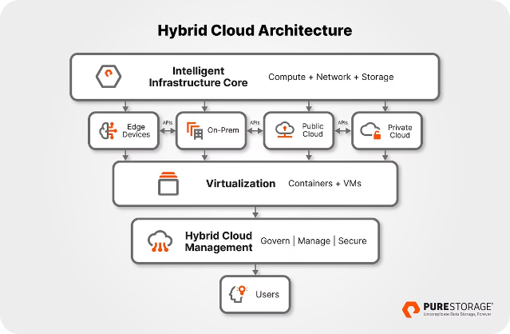
Introduction to Hybrid Cloud Integration
Hybrid cloud integration combines the power and scalability of public cloud services with the security and control of private infrastructure. This approach provides organizations with the flexibility to select the optimal environment for each workload, optimizing cost, performance, and compliance.
NAME: ALA VENKATA NARASIMHA RAO
REGISTER NO:192210730L
SUBJECT CODE: CSA1590
NA

Slide 2
Integration Architecture
Hybrid Integration Patterns
Data Orchestration
Monitoring and Visibility
Automating the flow of data between disparate systems, ensuring consistent, reliable, and secure data exchange across the hybrid environment.
Comprehensive monitoring and visibility across the hybrid ecosystem, providing real-time insights into system performance and health.
Leveraging a variety of integration patterns, such as API-led connectivity, event-driven architecture, and microservices, to seamlessly connect on-premises and cloud-based systems.

Slide 3

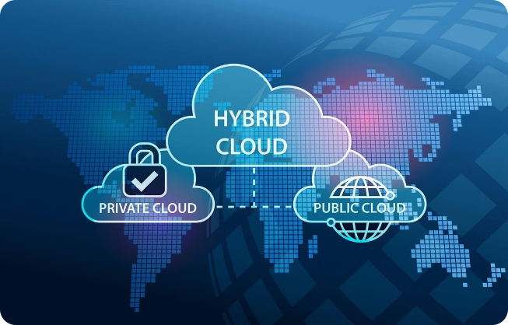
Data Security and Compliance
1
Data Encryption
Ensure sensitive data is encrypted both at rest and in transit, using robust encryption algorithms and key management policies.
2
Access Control
Implement granular access controls and identity management to limit access to sensitive data and resources based on user roles and permissions.
3
Regulatory Compliance
Adhere to industry regulations and standards, such as GDPR, HIPAA, and PCI-DSS, to maintain compliance across the hybrid cloud environment.

Slide 4

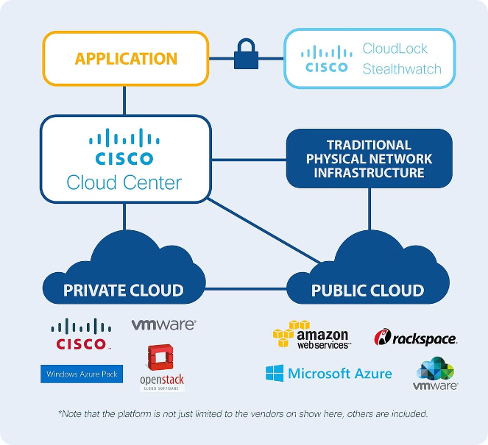
Performance and Reliability
1
Workload Optimization
Analyze and optimize workload placement across the hybrid cloud to ensure optimal performance, leveraging the strengths of each environment.
2
Disaster Recovery
Implement robust disaster recovery and business continuity strategies, with automated failover and recovery mechanisms across the hybrid infrastructure.
3
Scalability and Elasticity
Harness the scalability and elasticity of the public cloud to dynamically adjust resource allocation based on fluctuating demand, ensuring consistent performance.

Slide 5

Hybrid Cloud Management
Unified Governance
Automation and Orchestration
Monitoring and Optimization
Implement a centralized management platform to govern and orchestrate resources across the hybrid cloud, ensuring consistent policies and controls.
Leverage real-time monitoring and analytics to optimize resource utilization, identify performance bottlenecks, and ensure the overall health of the hybrid environment.
Automate provisioning, deployment, and management of hybrid cloud resources to increase efficiency and reduce the risk of human error.

Slide 6


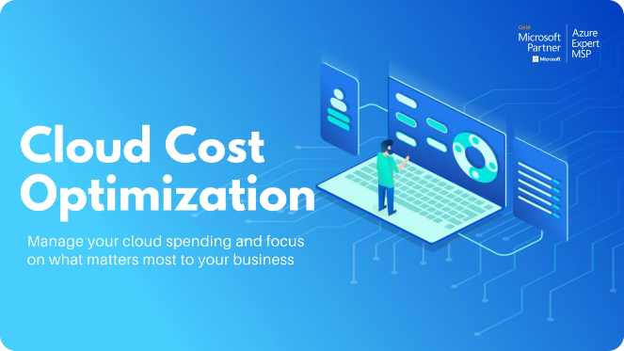


Cost Analysis
Cost Optimization
Continuously analyze and optimize cloud spending to eliminate waste and ensure cost-effective resource utilization across the hybrid environment.
Financial Forecasting
Develop accurate financial forecasts and budgets to plan and manage hybrid cloud costs, accounting for fluctuating resource demands and pricing models.
Cost Reporting
Implement comprehensive cost reporting and chargeback mechanisms to provide visibility and accountability for hybrid cloud expenditures across the organization.

Slide 7




Documentation
Architecture Diagrams
Process Workflows
Deployment Guides
Develop detailed architecture diagrams that clearly illustrate the hybrid cloud integration landscape, including system interconnections and data flows.
Document the end-to-end process workflows, including integration patterns, data transformations, and error handling procedures.
Provide comprehensive deployment and configuration guides to streamline the onboarding of new hybrid cloud services and components.

Slide 8

Conclusion and Key Takeaways
1
Flexibility and Scalability
2
Improved Security and Compliance
3
Cost Optimization
Hybrid cloud integration empowers organizations to leverage the best of both public and private cloud environments, enabling greater flexibility and scalability.
Careful cost analysis and optimization strategies can help organizations maximize the cost-effectiveness of their hybrid cloud investments, ensuring a strong return on investment.
By combining the security and control of on-premises infrastructure with the compliance capabilities of cloud services, hybrid cloud integration enhances data protection and regulatory adherence.

Slide 9
Future Scope
Emerging Technologies
Increased Automation
Hybrid Cloud Ecosystems
Advancements in areas like edge computing, serverless architectures, and AI/ML will continue to shape the future of hybrid cloud integration, enabling new use cases and capabilities.
The continued evolution of hybrid cloud management platforms and DevOps practices will drive greater automation and orchestration, simplifying the deployment and management of hybrid environments.
As organizations leverage a diverse array of cloud services and on-premises systems, the need for seamless integration and collaboration across hybrid cloud ecosystems will become increasingly important.

Slide 10


Thank You
Thank you for your time and attention. We hope this presentation has provided valuable insights into the world of hybrid cloud integration and its transformative potential for your organization.

